Slide 1
Overview of Basic Statistics in R
DATA-LA 485
Notes:
<number>

Slide 2
T-test
Independent -> Student t-test & Welch t-test
Dependent -> Paired samples
ANOVA
Chi-square test
Basic statistical tests
Notes:
<number>

Slide 3
What do these tests test?
Key to think about what types of variables you have.
Basic statistics
Test | What it tests
T-test | Differences in means between 2 groups
ANOVA | Differences in means across >2 groups
Chi-square | Differences in proportions between groups
Notes:
<number>

Slide 4
What is the null hypothesis of each of these tests?
Null hypotheses
Test | Null hypothesis
T-test | H₀:
ANOVA | H₀:
Chi-square | H_{o}:
Notes:
<number>

Slide 5
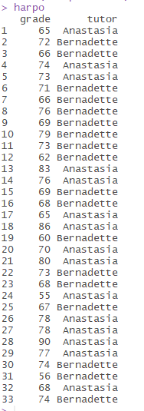
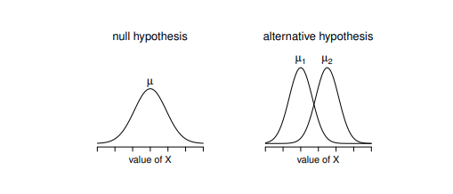
The independent samples (student) t-test
The goal is to determine whether two “independent samples” of data are drawn from populations with the same mean (the null hypothesis) or different means (the alternative hypothesis).
Independent – no relationship between data points (for instance, each data point comes from a different person).
Question: Are the grades of students who are taught by different instructors / TA’s significantly different?
We have 2 TA’s: Anastasia & Bernadette
Dataset = “harpo.Rdata”
Independent Samples student t-test
Data comes from: https://learningstatisticswithr.com/
Notes:
Packages = psych, lsr
<number>

Slide 6

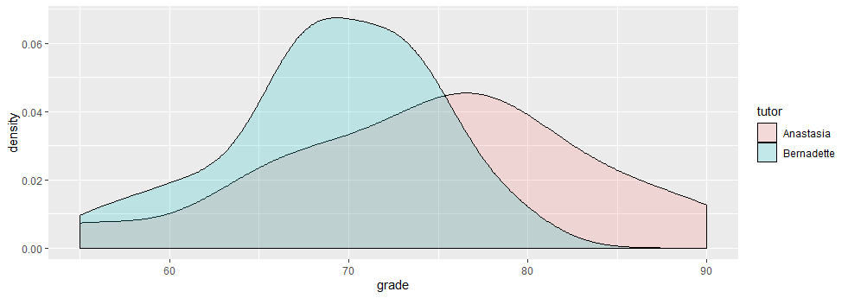
What are our variables?
What type of variables are they? (Binary, Categorical, Continuous)?
How might we visually display (or conduct descriptive statistics) to see the differences (if any exist) between the TAs?
Variables?
Notes:
library(tidyverse)
harpo %>% group_by(tutor) %>% summarize(mean=mean(grade), sd=sd(grade))
harpo %>% ggplot(aes(grade, fill=tutor)) + geom_density(alpha=0.2)
harpo %>% ggplot(aes(grade, fill=tutor)) + geom_histogram() + facet_grid(.~ tutor)
<number>

Slide 7

Two samples of data are collected and the sample means calculated. These means might differ by either a little or a lot.
If the samples come from the same population, then we expect their means to be roughly equal. Although it is possible for their means to differ by chance alone, we would expect large differences between sample means to occur very infrequently.
We compare the difference between the sample means that we collected to the difference between the sample means that we would expect to obtain if there were no effect. We use the standard error as a gauge of the variability between sample means.
If the difference between the samples we have collected is larger than what we would expect based on the standard error then we can assume one of three things:
There is no effect and sample means in our population fluctuate a lot and we have, by chance, collected two samples that are atypical of the population from which they came.
The assumptions of the t-test are not met.
The two samples come from different populations but are typical of their respective parent population. In this scenario, the difference between samples represents a genuine difference between the samples (and so the null hypothesis is incorrect).
T-test rationale
t | = | observed difference between sample means | − | expected difference between population means (if null hypothesis is true)
 |  | estimate of the standard error of the difference between two sample means
Notes:
<number>

Slide 8

For student t-test, we assume that the two groups have the same population standard deviation (this is an assumption of the test)
To calculate the “pooled” standard error, we take a weighted average of the variance estimates of each sample standard deviation.
Or another way to think about it is: we calculate the deviations for each value separately for each group, square it, sum it up, and then divide by N-2. Then take the square root.
Calculating the pooled standard error for student t-test
Notes:
Note: divide by N-2 because the variance now relies on two sample means, introducing more bias than a simple straight standard deviation, so we subtract 2 instead of 1.
<number>

Slide 9
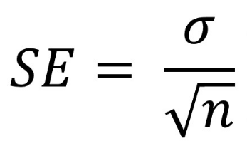

Calculating the standard error of the difference between two sample means
Similar to previous formulas of SE where SE = st dev / sqrt(n) – this looks similar
Once the t-statistic is calculated, one can get the corresponding p-value off of a chart OR by using dt() (density of t-distribution for a particular t-score with df (where df=n-2)
Notes:
<number>

Slide 10
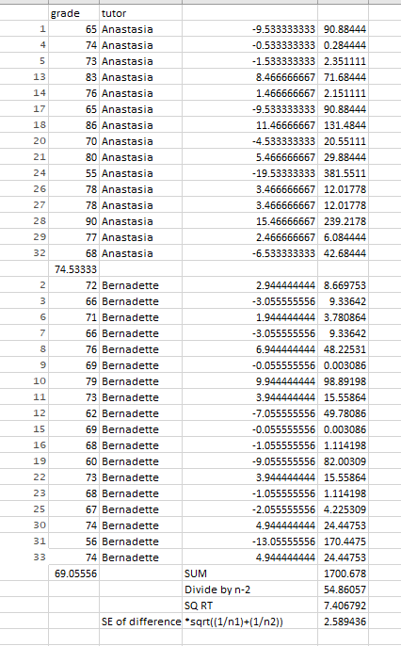
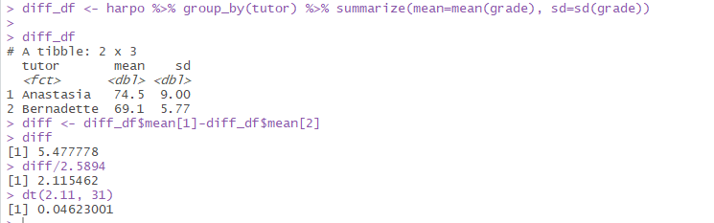
Calculating by hand
Notes:
<number>

Slide 11
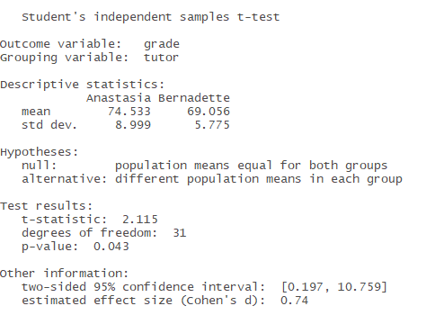
library(lsr)
independentSamplesTTest(formula = grade ~ tutor, data=harpo, var.equal=TRUE)
OR
t.test(grade ~ tutor, data=harpo, var.equal=TRUE)
Calculating this in R
Confidence interval of the difference
Measure of effect size; read text for details
Notes:
<number>

Slide 12
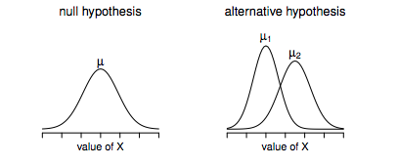
Normality – We assume that both groups are normally distributed
Independence – We assume that each observation is independent of the others
Homogeneity of Variance (also known as homoscedasticity) – the variance is the same across both groups
If the homogeneity of variance assumption is not met, then you can run the Welch t-test – which has the same assumptions, except homogeneity of variance.
Assumptions of the t-test
Notes:
<number>

Slide 13


t | = | observed difference between sample means | − | expected difference between population means (if null hypothesis is true)
 |  | estimate of the standard error of the difference between two sample means
Welch t-test
The standard error of the difference between two sample means is calculated differently
And degrees of freedom are calculated as (and don’t have to be an integer value):
Notes:
<number>

Slide 14
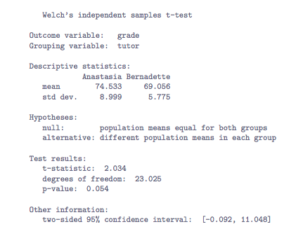
Same as student t-test, except:
independentSamplesTTest(formula = grade ~ tutor, data=harpo, var.equal=TRUE)
independentSamplesTTest(formula = grade ~ tutor, data=harpo)
OR
t.test(grade ~ tutor, data=harpo)
Running the Welch test in R
Notes:
What are the assumptions of the Welch t-test?
Normality and independence
<number>

Slide 15
For experimental designs with repeated measures, data points are not independent
Each person is measured twice – once in each experimental condition
This means that we need to conduct a paired-samples (or dependent) t-test
Paired samples t-test
Notes:
<number>

Slide 16

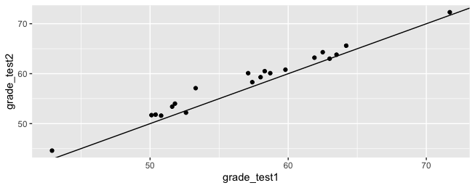
In this example, we have data from Dr. Chico’s class (data: chico.Rdata)
load(“chico.Rdata”)
head(chico)
We have 20 students who took 2 tests. We want to know if the grades improved across the two tests.
library(psych)
describe(chico)
How might we want to visualize these?
scatter plot
Data
We can see that almost all students do better on the 2nd test than the first
Notes:
MAD – median absolute deviation; compute median, calculate difference between value and median, take absolute value, get median of those values. (In textbook from class, talked about how this is multiplied by 1.4826 to approximate standard deviation.
chico %>% ggplot(aes(grade_test1, grade_test2)) + geom_point() + geom_abline()
<number>

Slide 17
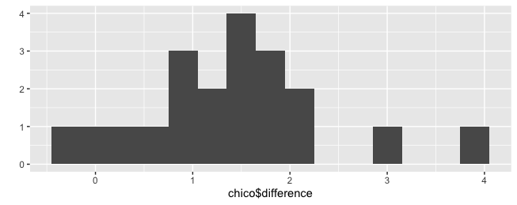
We can calculate the different: grade_test2 – grade_test1
Let’s put this back into the chico dataframe & then plot a histogram
Calculate the difference for each person
Notes:
<number>

Slide 18

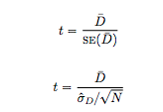
What is the null and alternative hypothesis in a paired samples t-test?
Null and Alternative Hypothesis
This is how we calculate the t-statistic:
Degree of freedom = n-1 = number of differences – 1 = 20-1 = 19
Notes:
<number>

Slide 19
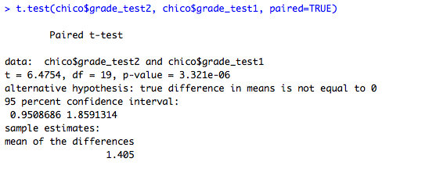
Paired t-test in R
What happens when you switch grade_test2 and grade_test1?
Notes:
<number>

Slide 20
The difference scores are normally distributed
The data is “paired”
Assumptions of the paired t-test
Notes:
<number>

Slide 21
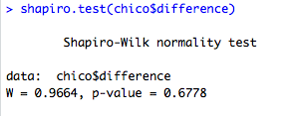
How can we test assumptions of normality?
QQ-plot
harpo %>% filter(tutor=="Anastasia") %>% ggplot(aes(sample=(grade))) + geom_qq()
OR
harpo %>% filter(tutor=="Anastasia") %>% ggplot(aes(sample=scale(grade))) + geom_qq() + geom_abline()
OR
qqnorm(chic0$difference)
Note: Be sure to do it for each sample in an independent samples t-test
Shapiro-Wilk test: Tests for normality
Null hypothesis: distribution is normal
Alternative hypothesis: distribution is non-normal
shapiro.test(chico$difference)
P-value > 0.05 suggests that there is not sufficient evidence in favor of the alternative hypothesis, but Shapiro-Wilk test is most likely to find differences with large sample sizes – when normality is least of a concern.
How to test assumptions?
Notes:
anastasia <- harpo %>% filter(tutor=="Anastasia")
shapiro.test(anastasia$grade)
bernadette <- harpo %>% filter(tutor=="Bernadette")
shapiro.test(bernadette$grade)
<number>

Slide 22

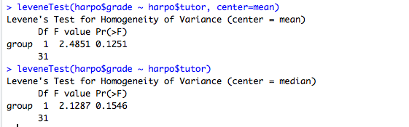
How can we test homogeneity of variance?
Levene’s test – calculates the absolute difference of each point from its group mean and then compares the means across groups
Brown-Forsythe test – same as Levene’s except uses group median
In R,
Levene’s test:
leveneTest(harpo$grade ~ harpo$tutor, center=mean)
Brown-Forsythe test:
leveneTest(harpo$grade ~ harpo$tutor)
How to test assumptions?
Notes:
<number>

Slide 23
We will examine a fictive dataset called: clinicaltrial.Rdata, which includes data on a new antidepressant drug called Joyzepam. In order to construct a fair test of the drug’s effectiveness, the study involves three separate drugs to be administered. One is a placebo, and the other is an existing antidepressant / anti-anxiety drug called Anxifree. A collection of 18 participants with moderate to severe depression are recruited for your initial testing. Participants are randomly assigned (doubly blinded, of course) a treatment. A psychologist assesses the mood of each person after a 3 month run with each drug: and the overall improvement in each person’s mood is assessed on a scale ranging from -5 to 5.
load(“clinicaltrial.Rdata”)
head(clin.trial)
gmeans <- clin.trial %>% group_by(drug) %>% summarize(mean = mean(mood.gain), sd = sd(mood.gain))
ANOVA
Notes:
What is the first thing you want to do for this data?
<number>

Slide 24
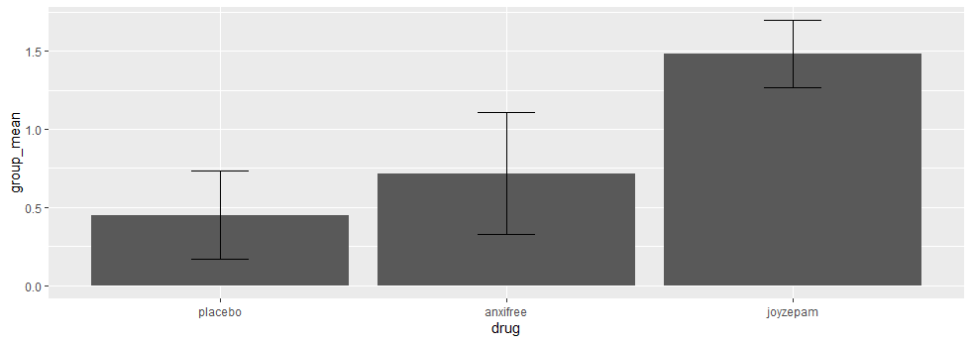
gmeans %>% ggplot(aes(drug, group_mean)) + geom_bar(stat="identity") + geom_errorbar(aes(ymin=group_mean - sd, ymax=group_mean + sd), width = 0.2)
Plot differences
Notes:
<number>

Slide 25
Null hyothesis:
Like a t-test, ANOVA tests the null hypothesis that the means are the same.
Experimental hypothesis:
The means differ.
ANOVA is an omnibus test
It test for an overall difference between groups.
It tells us that the group means are different.
It doesn’t tell us exactly which means differ.
ANOVA
Notes:
<number>

Slide 26
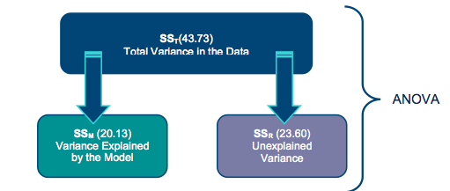
We compare the amount of variability explained by the model (experiment), to the error in the model (individual differences)
This ratio is called the F-ratio.
If the model explains a lot more variability than it can’t explain, then the experimental manipulation has had a significant effect on the outcome (DV).
Theory of ANOVA
Notes:
<number>

Slide 27
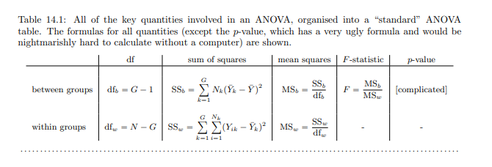
Within groups
Theory of ANOVA
Between groups
Notes:
<number>

Slide 28
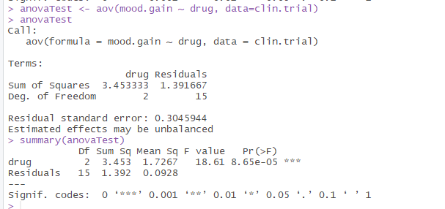
ANOVA in R
Notes:
Estimated effects may be unbalanced – a warning because ANOVA expects balanced designs (same numbers in each group).
<number>

Slide 29
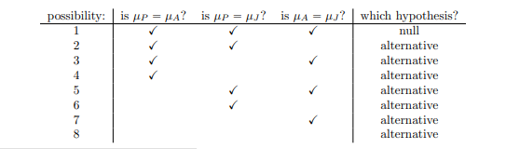
Post-hoc tests
Why can’t we run a bunch of t-tests?
We are increasing the chance of making a type I error (if we have alpha = 0.05, then we expect there to be a significant difference by chance 5% of the time), but if we run 3 tests – then we increase the likelihood of a type 1 error to: 1 - 0.95³ = 1 - 0.85 = .15 or 15% chance
Notes:
<number>

Slide 30
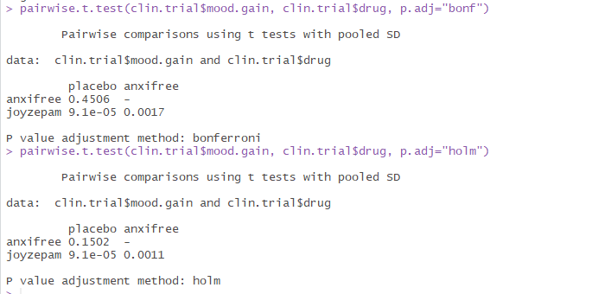
What corrections do you know?
Bonferroni correction: divide alpha by number of comparisons: .05/3 = 0.0167
pairwise.t.test(clin.trial$mood.gain, clin.trial$drug, p.adj="bonf")
Bonferroni is a very conservative test – generally, people like to use other tests
Holm correction: pretend that you’re doing the tests sequentially; starting with the smallest p-value and moving onto the largest one. See details in your book. It has the same Type 1 error rate, but it has more power than Bonferroni.
pairwise.t.test(clin.trial$mood.gain, clin.trial$drug, p.adj=“holm")
Correction for Multiple Comparisons
Notes:
<number>

Slide 31
Post hoc tests (using the Holm correction to adjust p) indicated that Joyzepam produced a significantly larger mood change than both Anxifree (p = .001) and the placebo (p = 9.1 x 10⁵). We found no evidence that Anxifree performed better than the placebo (p = .15).
Communication
Notes:
<number>

Slide 32
What are the assumptions of ANOVA?
Normality of residuals (or error terms)
anovaResiduals <- residuals(anovaTest)
qqnorm(anovaResiduals)
shapiro.test(anovaResiduals)
2. Homogeneity of Variance (and balanced designs)
if this isn’t met – you can use a Welch one-way test
oneway.test(mood.gain ~ drug, data = clin.trial)
you can do post-hoc tests that don’t assume equal variances as well, including: Games-Howell test
3. Independence
Assumptions
Notes:
<number>

Slide 33
Reflect:
What are you looking forward to about this Service Learning experience? What are your hesitations? What are you most eager to learn?
What might be the biggest challenge to your learning? What assets do you bring to this experience?
Homework 1 – I’ll have it up in the next day or two.
Hands-On Projects
Notes:
<number>

